Slide 1
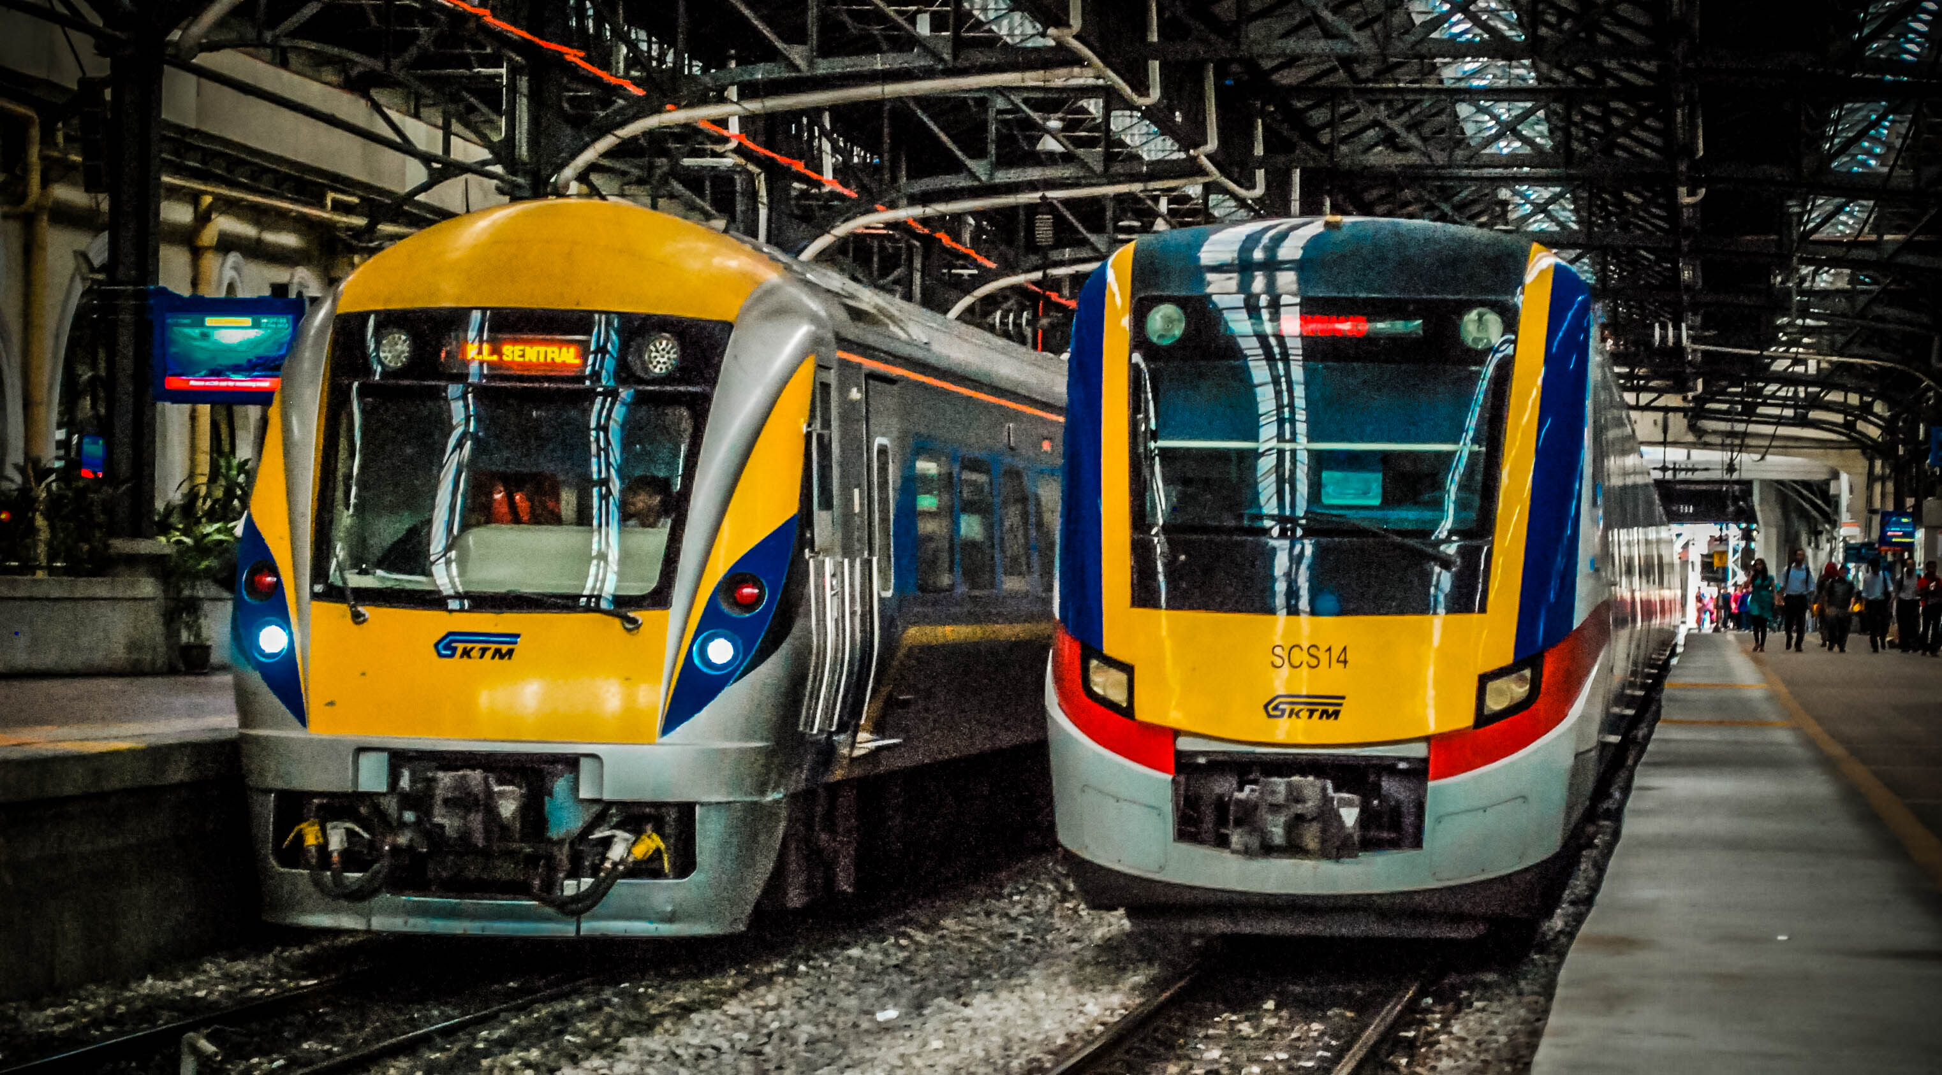
TRAIN TICKETING SYSTEM
GROUP 5
Shazana binti Mohammed Affandi
Siti Nur Asiyah binti Zukfily
Nurul Athirah binti Zaini
Nurul Fatihah binti Zamri

Slide 2
INTRODUCTION
Train Ticketing System kiosk for the users to get the ticket in the easiest way without having to queue at the counter.
To encourage people to use public transport by providing them an effective system to show the exact price for each destination, the train schedule and the routes to ease their journey.

Slide 3
PROBLEM STATEMENT
People have problem to travel because they do not know the stations for the train to stop.
People who do not usually take train tend to waste their time on transportation because they do not know the best route to go to their destination.
People do not know the exact price and the time schedule for the train

Slide 4
DEMO PROJECT

Slide 5
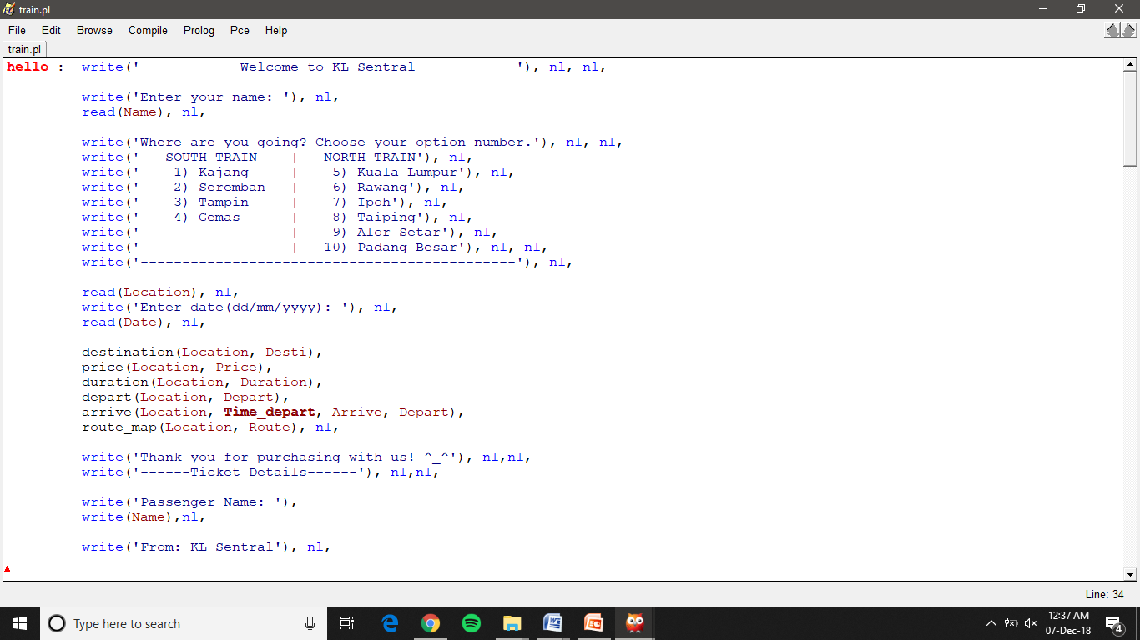
PROLOG PROGRAM

Slide 6
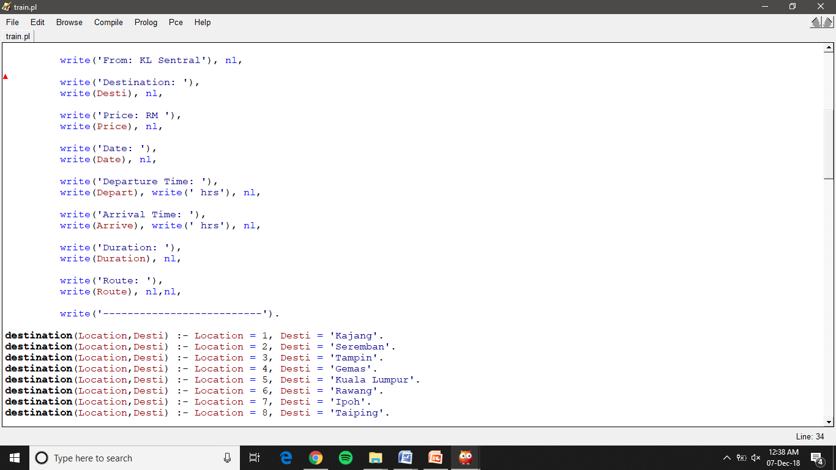

Slide 7
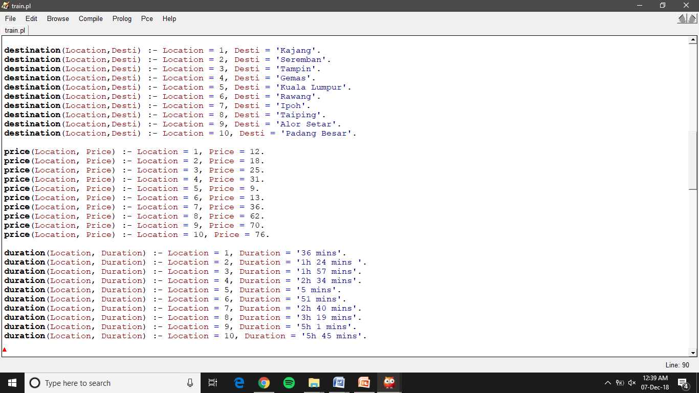

Slide 8
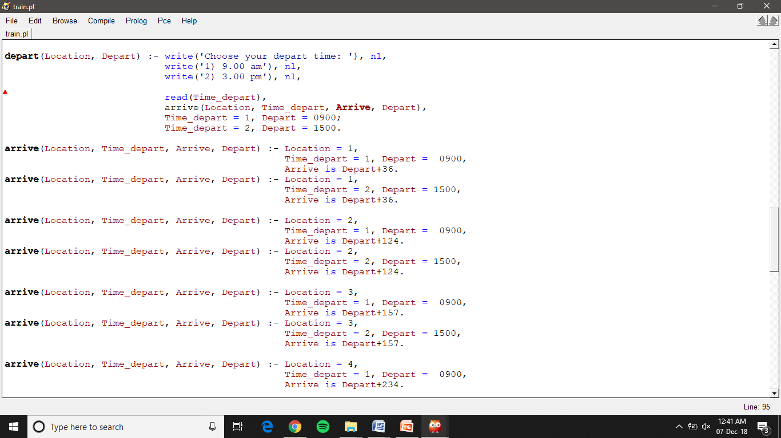

Slide 9
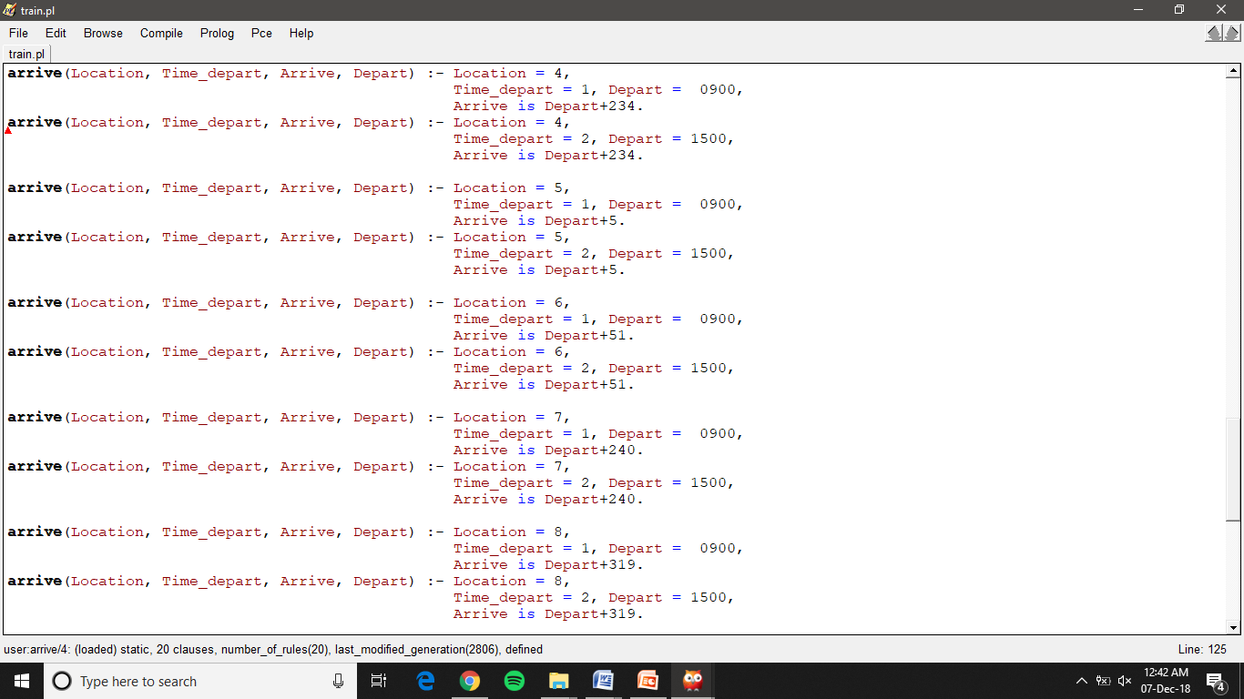

Slide 10
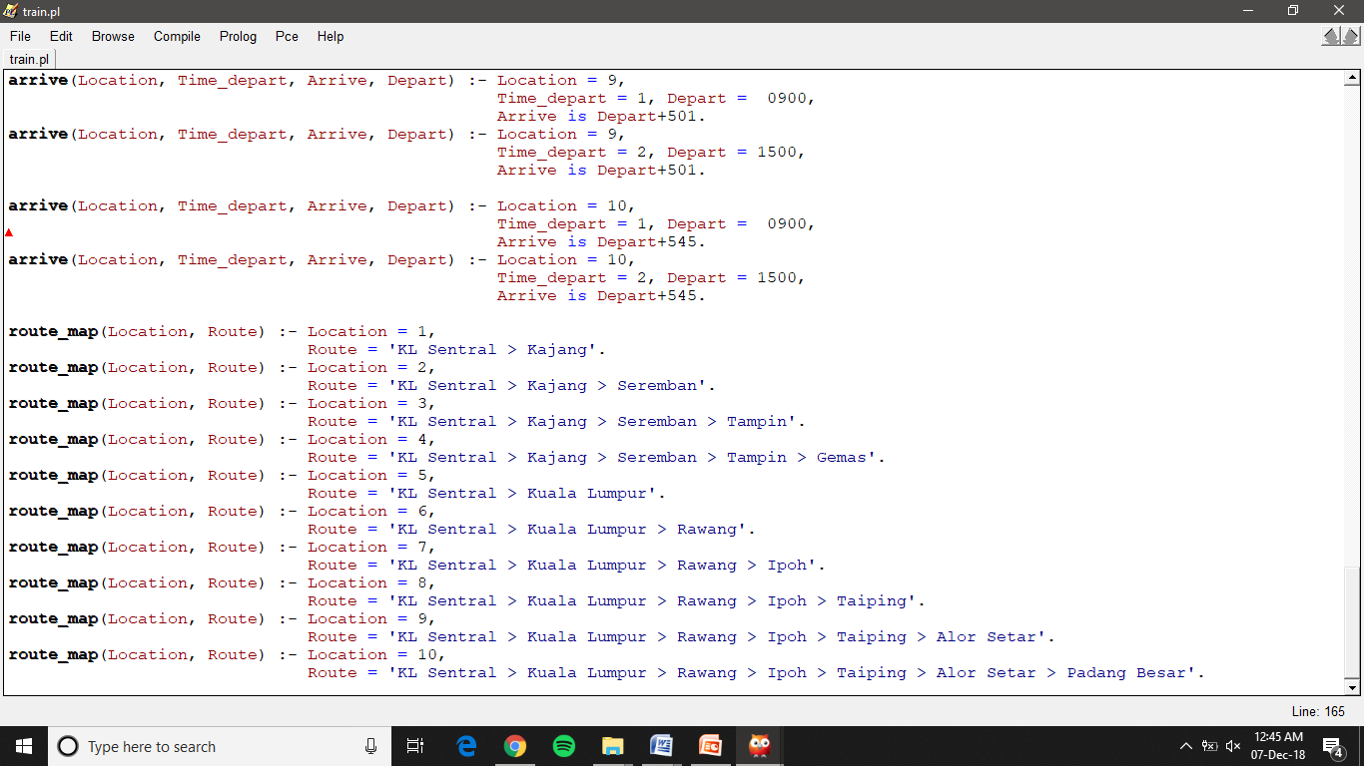

Slide 11
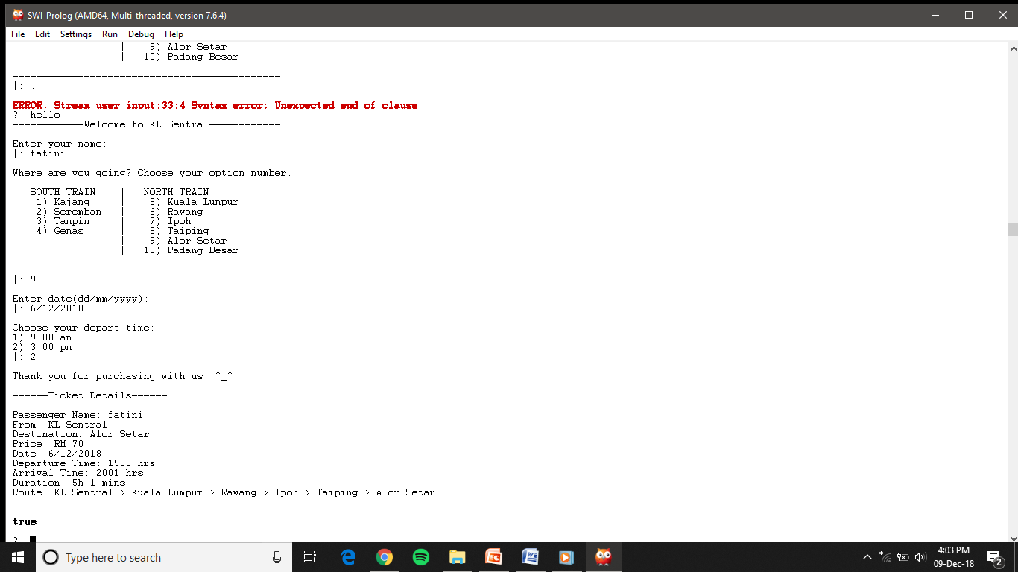
SAMPLE OUTPUT

